Slide 1
FLEXBOX
Flexbox was introduced in 2009 as a new layout system, with the goal to help us build responsive web pages and organize our elements easily
Flexbox layout give the container the ability to alter its items’ width/height to best fill the available space (~accommodating all kind of display devices)
Why use Flexbox?
It’s supported in all major browsers
You don’t have to worry about syntax
You can manipulate inline elements easily
It simplifies complexity

Slide 2
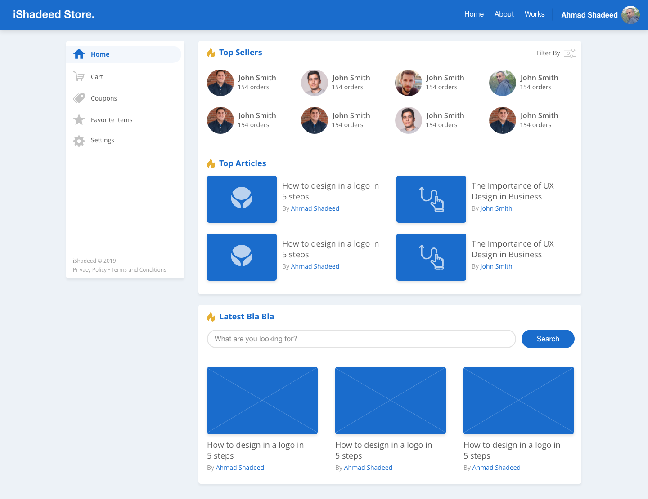
FLEXBOX PROPERTIES
flex-wrap: wrap;
flex-basis: 250px;
flex: 0 0 25%;
flex-direction: column;
align-items: flex-start;

Slide 3
The FLEXBOX Properties:
flex-direction
flex-wrap
flex-flow
justify-content
align-items
align-content
order
flex-grow
flex-shrink
flex-basis
flex
align-self
Notes:
. A flex container expands items to fill available free space or shrinks them to prevent overflow.

Slide 4
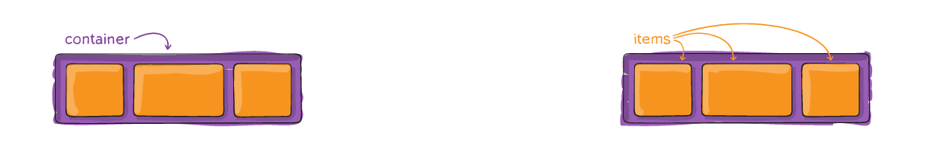
Demo
Properties for:
The Flex Container (Parent element)
The Flex Items (The Child Element)

Slide 5
Thank you!

Slide 6
Reference Links
https://ishadeed.com/article/flexbox-real-world-use-cases/
https://css-tricks.com/snippets/css/a-guide-to-flexbox/
https://flexboxfroggy.com/
https://www.w3schools.com/css/css3_flexbox.asp

